Slide 1
JAVA PROJECT
Farmers Market
Price & Sales Tracker
A practical Java console program for recording crop prices,
quantity sold, and total sales value.
PRESENTED BY :
Rohita – 2620040040
Sanjana - 2620090024

Slide 2
ABSTRACT : FARMER’S MARKET PRICE AND SALES TRACKER
The Farmers Market Price and Sales Tracker is a software application designed to help farmers manage and monitor the prices and sales of their agricultural products. Farmers often face difficulties in keeping track of changing market prices, daily sales, quantities sold, and overall income.
This system provides a simple and organized platform to record product details, market prices, sales quantities, and revenue. The application allows farmers to add and update information about crops, view current or recorded market prices, and maintain sales records.
It can also calculate total sales and revenue, helping farmers understand their business performance. By maintaining digital records, the system reduces manual paperwork and makes information easier to access and manage.
The proposed system aims to improve decision-making, sales management, price tracking, and financial record-keeping for farmers. It provides a user-friendly and efficient solution that can help farmers better understand market trends and manage their agricultural products effectively.
02 / 12

Slide 3
CO1 • BTL3 • APPLY
From Problem to Program
Convert a real-world task into a precise algorithm and a working Java program.
Algorithm
Java fundamentals
1. Read the crop name
2. Read price per kilogram
3. Read quantity sold
4. total = price × quantity
5. Display the sales report
String stores the crop name
double stores price and quantity
Scanner reads console input
Arithmetic expression calculates total
println() prints the result
EXAMPLE
₹25 per kg × 40 kg = ₹1,000 total sales revenue
03 / 12

Slide 4
CO2 • BTL4 • ANALYZE
Control Flow
Selection and iteration help the program validate data and process more than one crop record.
01 Selection
02 Iteration
03 Termination
if / else checks conditions.
Reject negative price or quantity.
switch can handle menu choices.
for, while, or do-while can repeat record entry.
A loop supports multiple sales.
Use a clear exit condition.
Update loop state correctly.
Prevent accidental infinite loops.
if (price < 0 || quantity < 0) {
System.out.println("Values cannot be negative");
}
Validation example
04 / 12

Slide 5
CO3 • BTL4 • ANALYZE
Methods, Recursion & Arrays
Modularise the logic and scale from a single sale to a collection of crop records.
Methods
1-D & 2-D arrays
Recursion & patterns
calculateSales(price, quantity)
Reusable methods reduce duplication and make testing easier.
1-D: store prices or quantities.
2-D: represent rows and columns of records.
Recursion solves suitable self-similar tasks.
Traverse arrays, search records, and sort values.
Possible analysis: calculate totals, find the highest sale, and sort crops by price.
05 / 12

Slide 6
CO4 • BTL6 • CREATE
Objects That Fail Safely
Model a sale as an object and handle invalid input in a controlled way.
Object-oriented model
Exception handling
Class: CropSale
Fields: cropName, pricePerKg, quantity
Methods: calculateTotal(), displayReport()
Encapsulation: keep fields private.
try-catch handles input errors.
Validate values before calculating.
finally supports cleanup when needed.
Close resources after use.
DESIGN GOAL
Keep records consistent, explain errors clearly, and avoid unexpected failure.
06 / 12

Slide 7
CO5 • BTL4 • ANALYZE
Strings, Library Algorithms & Files
Add text processing and persistence so records can be searched, sorted, and reused.
String & StringBuilder
Search & sort
File I/O
Store crop names as String.
Compare with equalsIgnoreCase().
Use StringBuilder to build reports.
Find a crop by name.
Sort records by price or sales value.
Use standard library algorithms and Comparator.
Write records to a text or CSV file.
Read them in later runs.
Handle IOException.
Future extension: save sales records and generate daily or monthly summaries.
07 / 12

Slide 8
CO6 • BTL6 • CREATE
Collections & Streams
Manage multiple sales records and process them declaratively using Stream pipelines.
Collections
Lambdas & interfaces
Stream pipeline
List<CropSale>: ordered records.
Set: unique values.
Map: key-value lookup by crop name.
Lambdas express compact behaviour.
Functional interfaces define one abstract operation.
Use Comparator for sorting.
filter() selects records.
map() transforms values.
forEach() processes results.
collect() gathers results.
sales.stream()
.filter(sale -> sale.calculateTotal() > 500)
.forEach(System.out::println);
Example: process sales above ₹500.
08 / 12

Slide 9
CORE LOGIC
Theory — Algorithm, Data & Formula
INPUT
PROCESS
OUTPUT
crop: String
price: double (₹/kg)
quantity: double (kg)
total = price × quantity
Check values are non-negative.
Crop name
Price and quantity
Total sales value
PSEUDOCODE
START
READ crop, price, quantity
IF price < 0 OR quantity < 0
DISPLAY error
ELSE
total = price * quantity
DISPLAY report
END IF
STOP
IMPORTANT DISTINCTION
Total sales is revenue, not profit. Expenses are not deducted.
09 / 12

Slide 10
IMPLEMENTATION
Java Code — Part 1: Read Input
Use Scanner to accept the crop name, price per kilogram, and quantity sold.
import java.util.Scanner;
public class FarmersMarketTracker {
public static void main(String[] args) {
Scanner sc = new Scanner(System.in);
System.out.print("Enter crop name: ");
String crop = sc.nextLine();
System.out.print("Enter price per kg: ");
double price = sc.nextDouble();
System.out.print("Enter quantity sold (kg): ");
double quantity = sc.nextDouble();
String
Crop name text.
double
Numeric price and quantity.
Part 2 continues the calculation and report.
10 / 12

Slide 11
IMPLEMENTATION
Java Code — Part 2: Calculate & Display
double total = price * quantity;
System.out.println("\\n--- Sales Report ---");
System.out.println("Crop: " + crop);
System.out.println("Price per kg: Rs. " + price);
System.out.println("Quantity sold: " + quantity + " kg");
System.out.println("Total sales: Rs. " + total);
sc.close();
}
}
SAMPLE OUTPUT
Enter crop name: Tomato
Enter price per kg: 25
Enter quantity sold (kg): 40
--- Sales Report ---
Crop: Tomato
Total sales: Rs. 1000.0
Possible upgrades
• Reject negative values
• Format currency to 2 decimals
• Save records to a file
11 / 12

Slide 12
THANK YOU
Farmers Market Price & Sales Tracker
Thank you for your time.
Questions and suggestions are welcome.

Slide 13
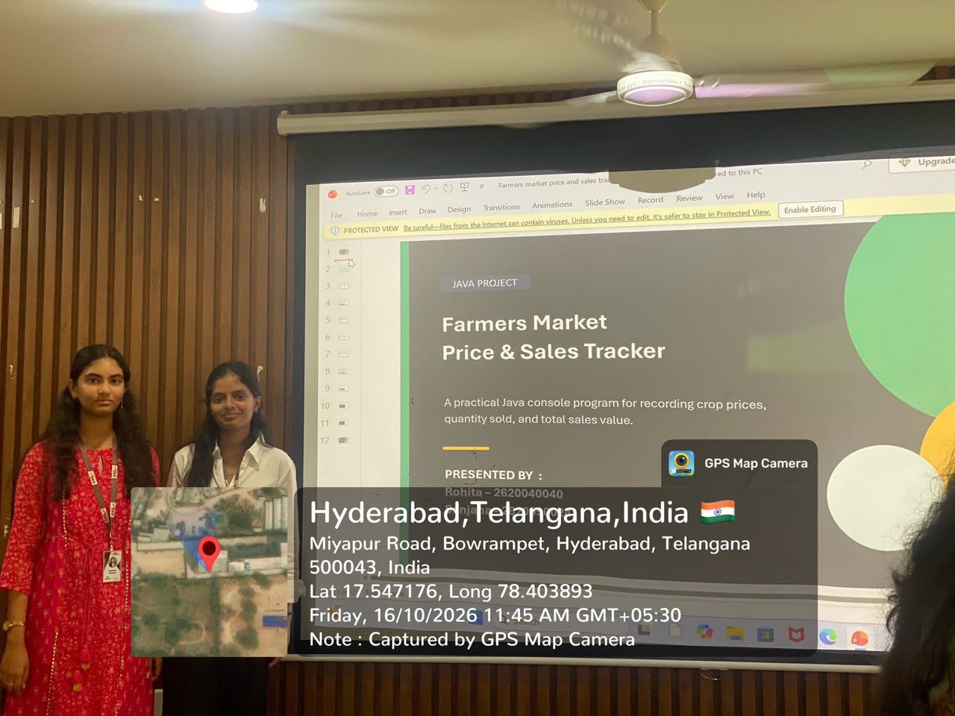
GEO TAG PIC :

